Slide 1
SOUTH HUNTINGTON SCHOOL DISTRICT
AMERICAN RESCUE PLAN
STAKEHOLDERS MEETING
(2020 – 2023)

Slide 2
Coronavirus Response and Relief Supplemental Appropriations Act (CRRSA)
District Allocation $5,629,094
2020/21 2021/22 2022/23
COVID 19 Response
Health & Safety: $ 1,360,000
Cleaning/Disinfecting Products
& PPE Supplies and Equipment
Academic: $ 2,200,000 $ 1,528,800 $ 540,294
Certified Permanent
Substitute Teachers

Slide 3
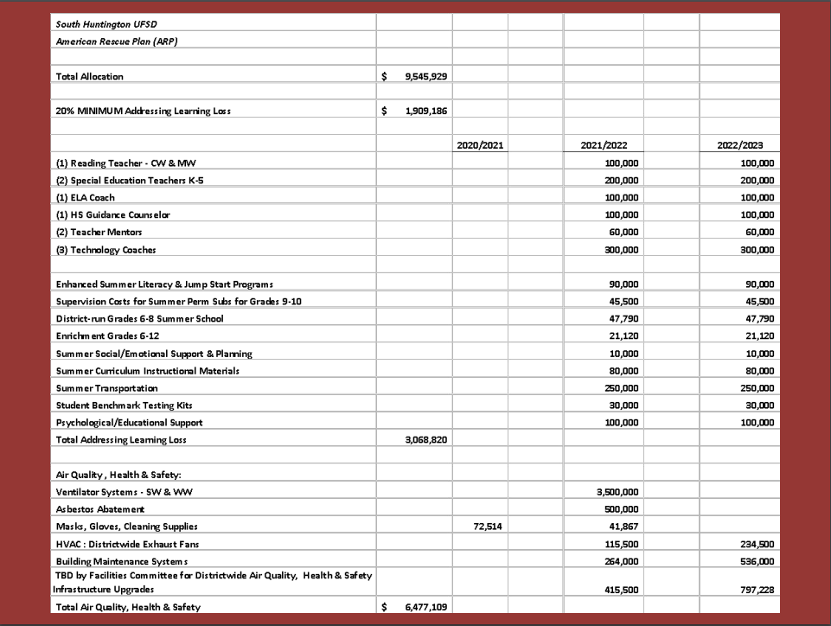

Slide 4
Additional $6.123 Million Foundation Aid Allocation 2021/2022 School Year
• Tax Levy Reduction $ 1,210,000
• Academic Pandemic Response Positions: $ 1,513,000
– Speech Teachers
– Special Education Teacher
– ENL Teacher
– Reading Teacher
– Social Studies/Science/Behavior Specialist (partial positions)
– Technology Integration Coach
– Makerspace Teacher
– Teaching Assistants
– Office Staff Support
• Reduction in use of Reserves $ 1,000,000
• Technology Upgrades & Enhancements $ 1,000,000
• Additional Capital Projects $ 1,400,000

